Slide 1


Slide 2



Who’s this guy?
Harikrishnan
@cn_harikrishnan (https://twitter.com/cn_harikrishnan?s=08)
https://www.linkedin.com/in/hari-krishnan-304a0272
cnharishkrish@gmail.com

Slide 3
Agenda
What is Xamarin?
Xamarin – Growing with you
Building great mobile apps
.NET 5 and mobile

Slide 4

Write Once, Run Anywhere

Slide 5


Slide 6

Xamarin + Xamarin.Forms
iOS C# UI
Android C# UI
Windows C# UI
Shared UI Code
Shared C# Backend
Shared C# Backend
Traditional Xamarin Approach
With Xamarin.Forms: More code-sharing, all native

Slide 7
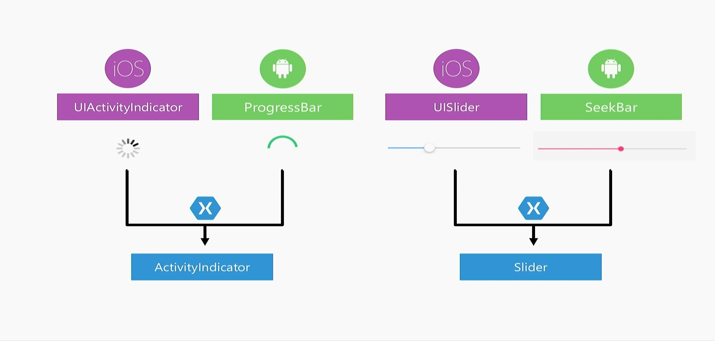
Xamarin.Forms Rendering Model

Slide 8

2009 – MonoTouch – .NET for the iPhone launches
iPhone 3G
480 x 320 display at 163 ppi
128 MB RAM
32 bit ARM at 412 Mhz
2 megapixel camera
PowerVR GPU at 150 Mhz

Slide 9
MonoTouch Launch
C# 3 vs Objective-C
LINQ
.NET class libraries(“mobile profile”)
3,386 iPhoneOS APIs
No generics support
No debugger
Limited code sharing

Slide 10

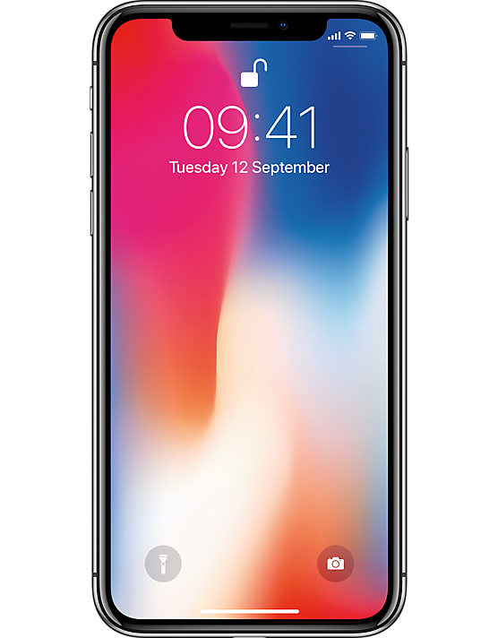
iPhone 3G
iPhone XS
480 x 320 display at 163 ppi
128 MB RAM
32 bit ARM at 412 Mhz
GeekScore ~ 120
2 megapixel camera
PowerVR GPU at 150 Mhz
2436 x 1125 pixel resolution at 458 ppi
4 GB RAM
A12 Bionic Chip (6 CPUs, 2@2.5Ghz, 4@1.59Ghz)
GeekScore(4,815 single core, 11,353 multi-core)
Neural Engine
Dual 12MP wide-angle & telephoto cameras
GPU 4-Core at > ~1.1Ghz

Slide 11
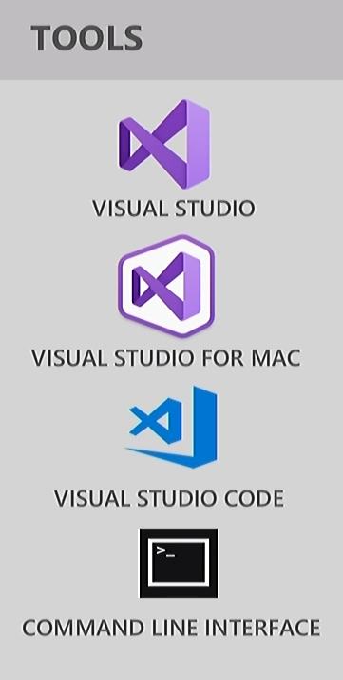
Today: Visual Studio 2019 and Xamarin
Native API support:
iOS: 97,749 (from 3,386)
Android 152,632
Code Sharing via .NET Standard 2
Cross-platform frameworks:
Xamarin.Forms
Xamarin Essentials
Use the same tools you know and love
Microsoft Learn (previously Xamarin University)
Reflection Emit, Dynamic, Assembly.Load on iOS
Free!

Slide 12
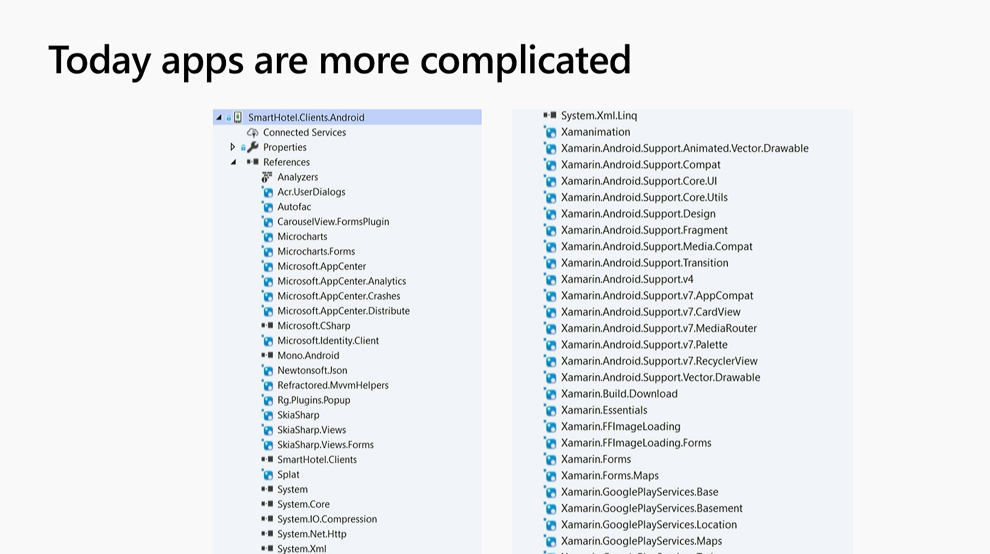

Slide 13
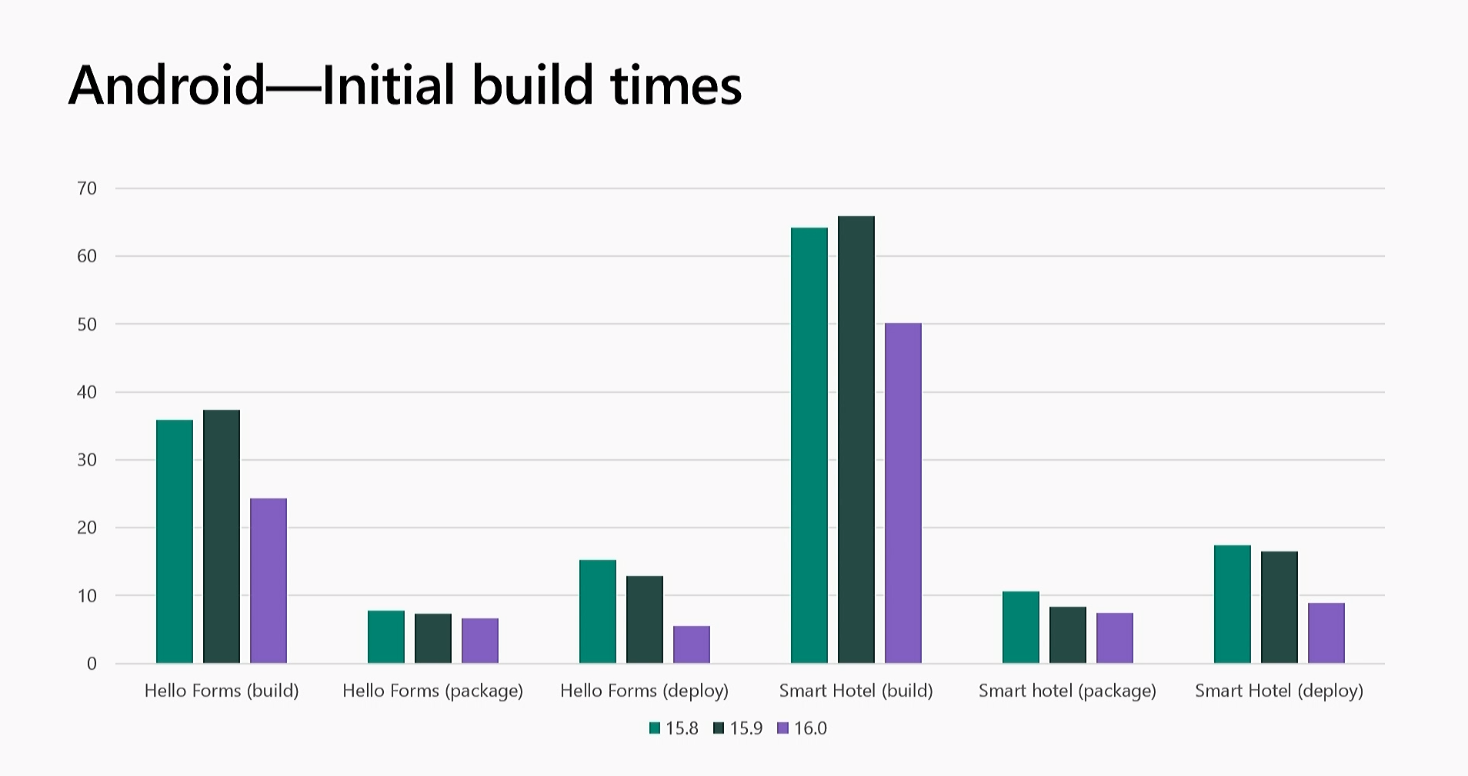

Slide 14
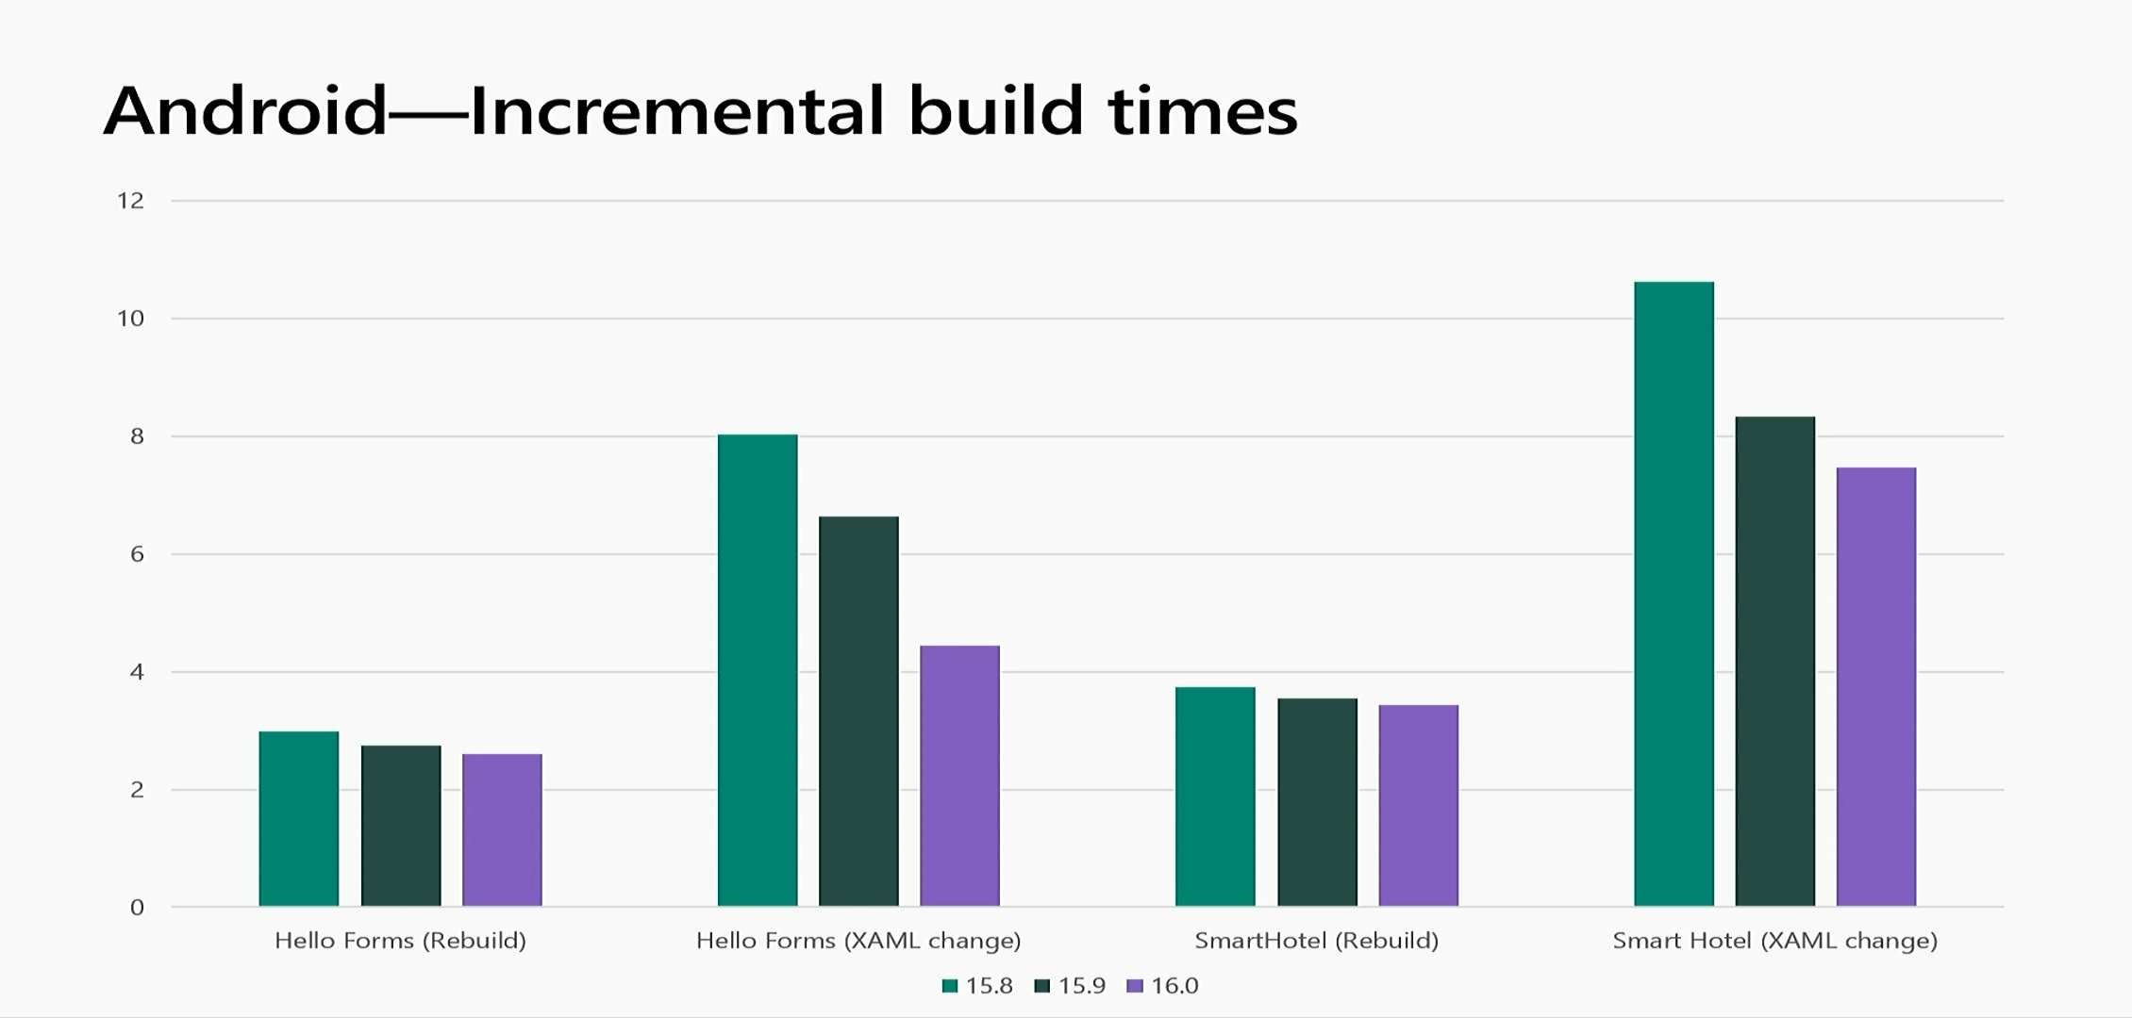

Slide 15
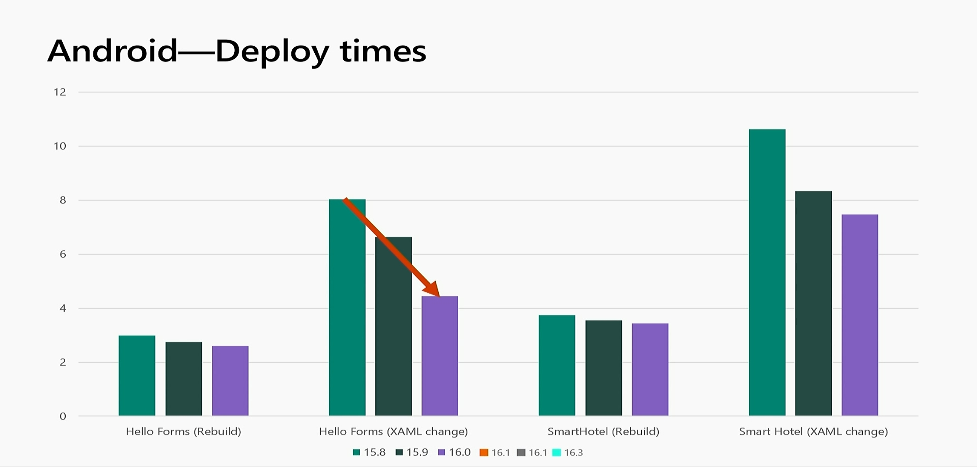
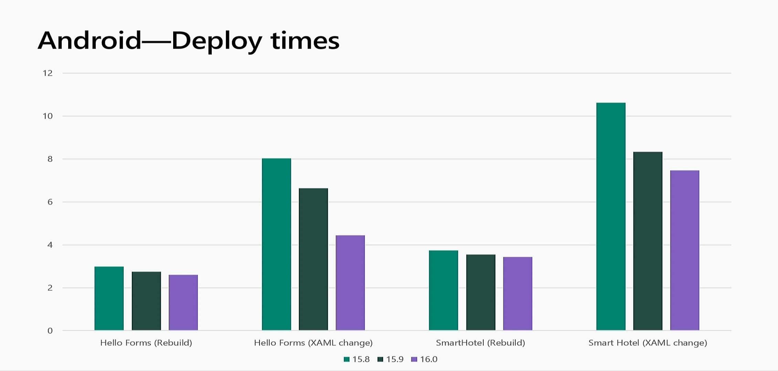
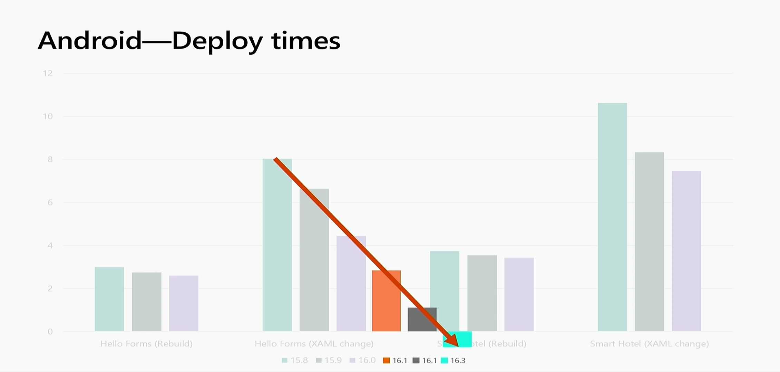

Slide 16
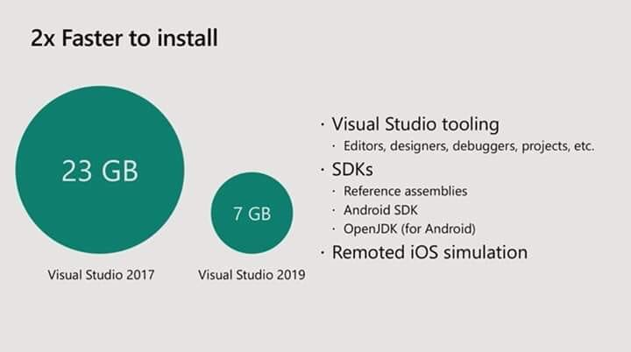
Focus on the Fundamentals
Tooling should work for you, not against you.
Lightweight installation
Xamarin workload in Visual Studio 2019 is now 3.28x smaller
Faster installation experience and a lower disk impact.
Simplified experience to acquire new Android SDKs and emulators

Slide 17
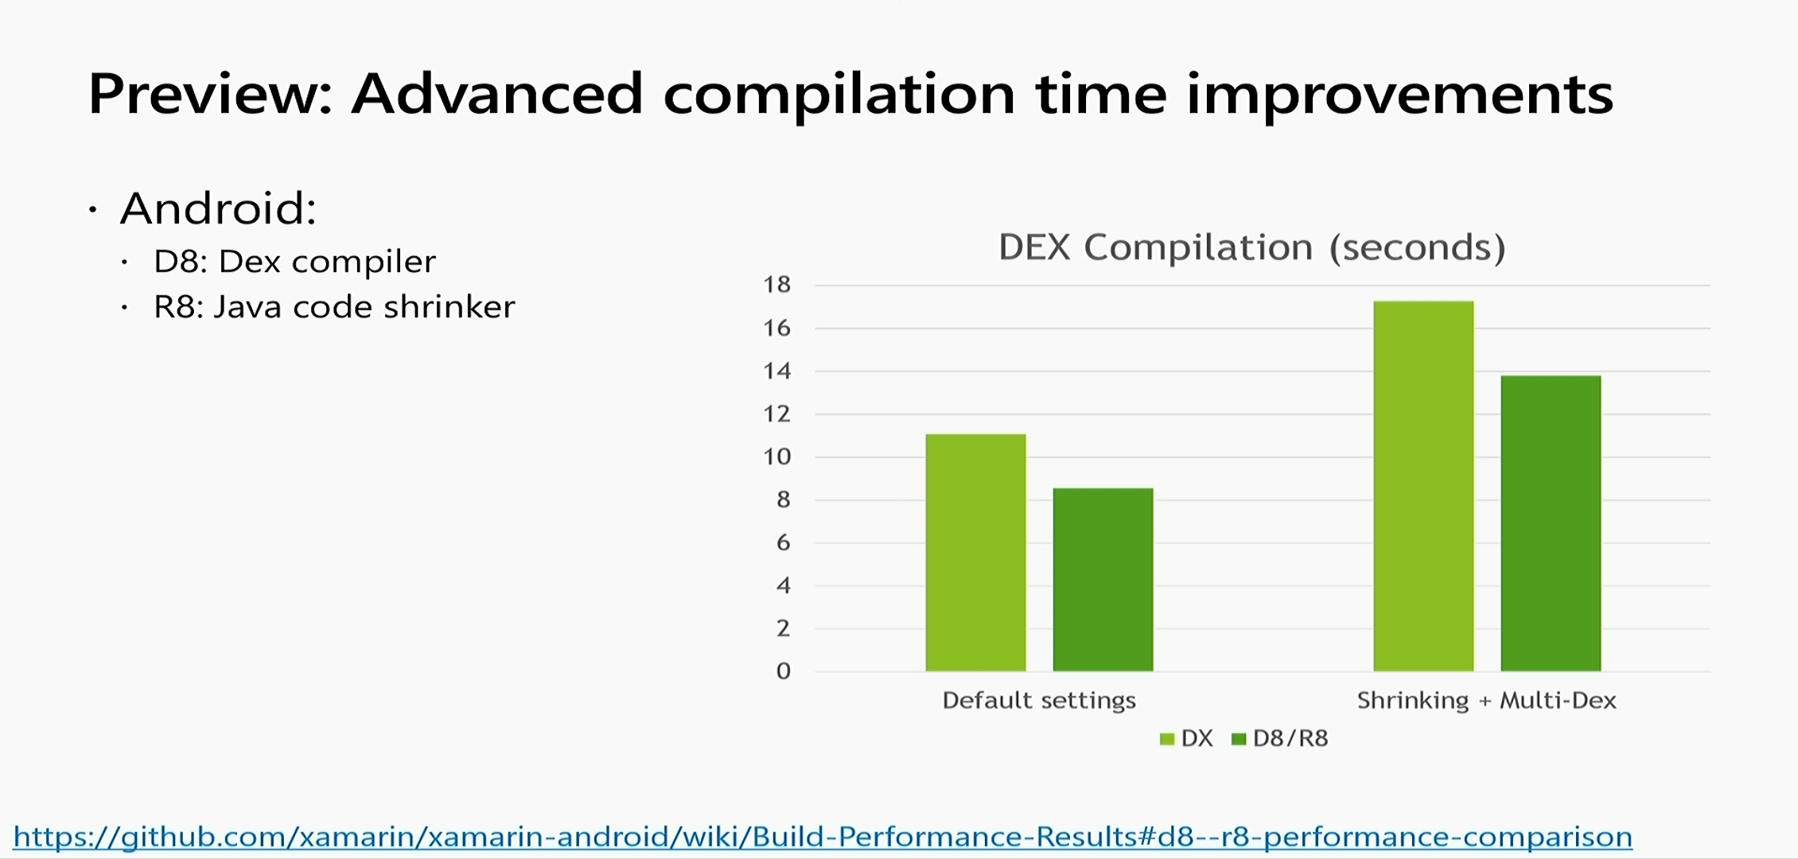

Slide 18
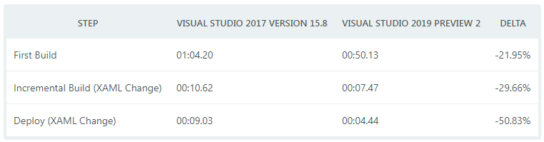
Faster Inner Development Loop
Smaller Workload Size
Visual Studio 2019 have decreased the size of the Xamarin workload by 50%!

Slide 19
Building mobile apps

Slide 20
Xamarin Native APIs
1:1 Mapping of native APIs to .NET
Everything you can do in Java, you can do with C#
Everything you can do with Obj-C or Swift you can do in C#
Deep object integration
Subclass native types in C# which are full fledged system types
The API mapping follows the .NET design guidelines
And makes native APIs composable with .NET (Async, enumerators, collections, and so on)

Slide 21
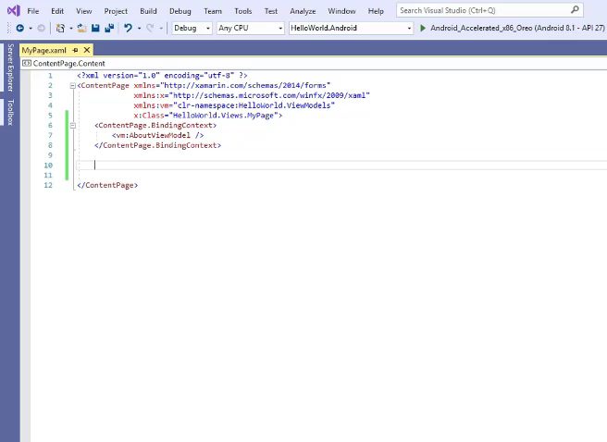
XAML IntelliSense and Intellicode

Slide 22
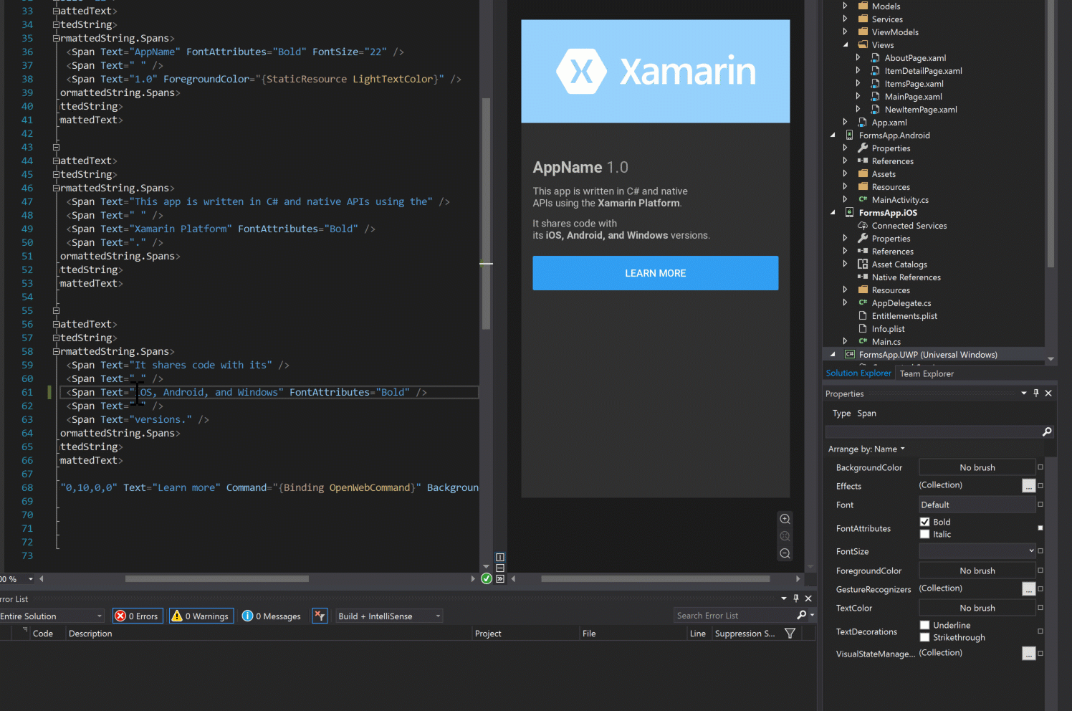
Xamarin.Forms Property Panel

Slide 23
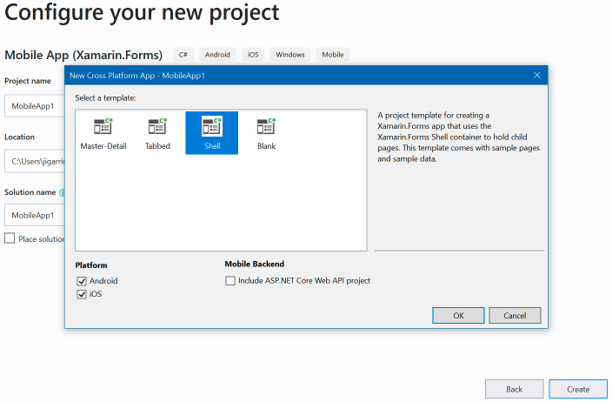
Xamarin Forms Shell Template
Provides a structure for your application
A single place to describe the visual structure of an application.
A common navigation UI
A powerful new URI based navigation service with deep linking.
Performance conscious data templates.
An integrated search handler.

Slide 24
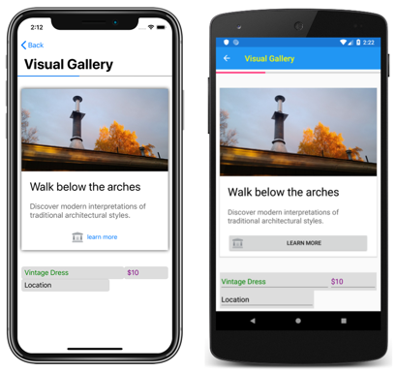
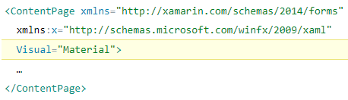
Consistent UI with Visual

Slide 25
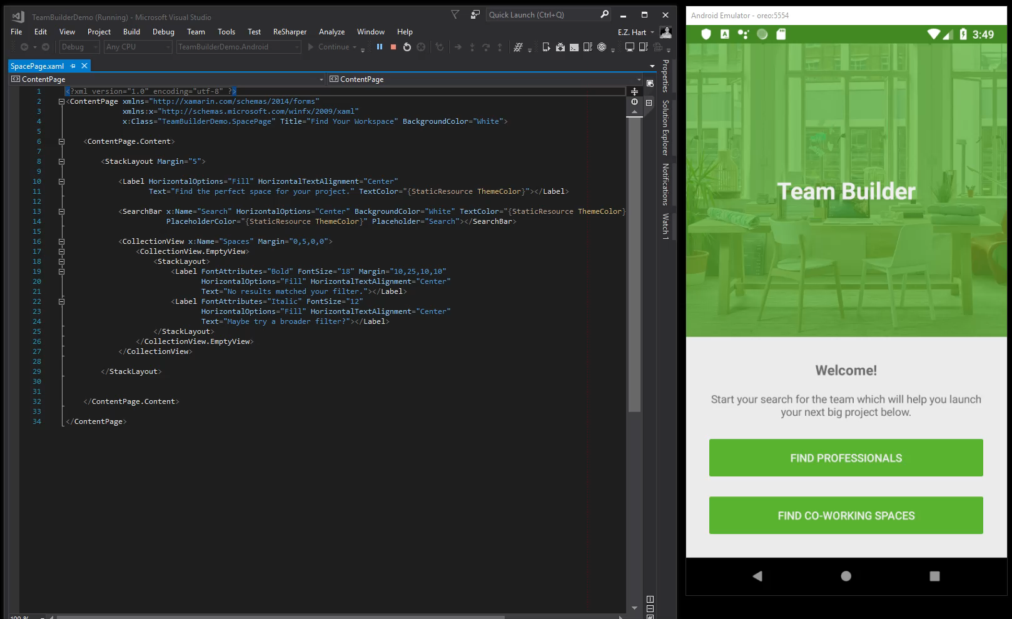
Xamarin.Forms CollectionView

Slide 26
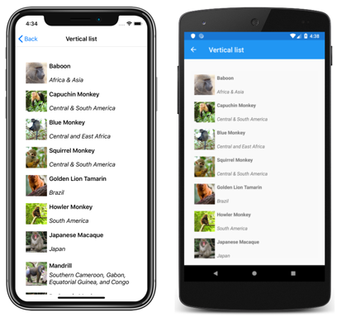


Slide 27
Cross-Platform Access to Platform Services
Xamarin.Essentials 1.0 is now available.
Easier than ever to access non-UI platform APIs from shared code.
Supported Platforms
iOS (10+)
Android (4.4+)
https://github.com/xamarin/Essentials

Slide 28
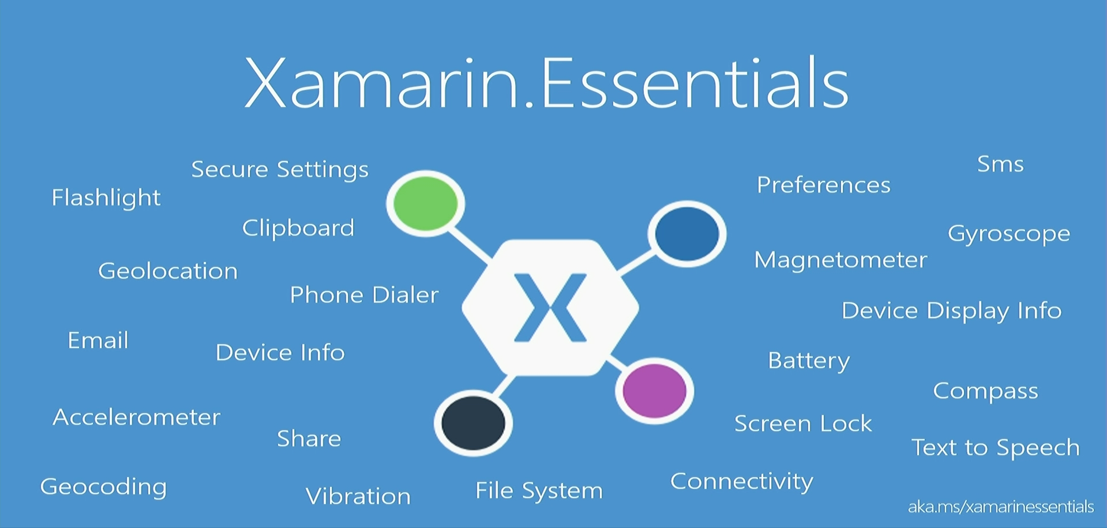

Slide 29
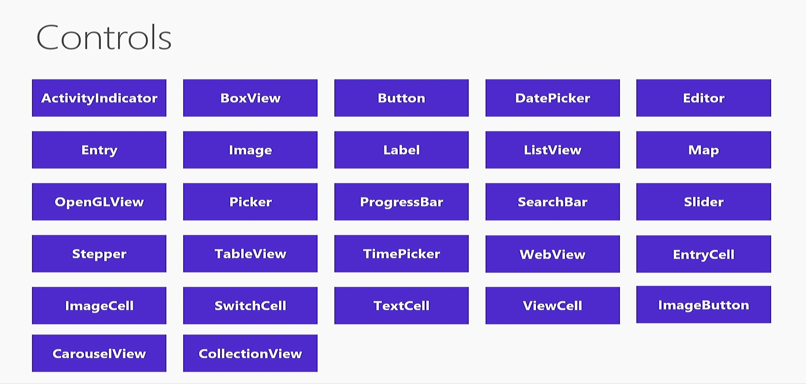

Slide 30
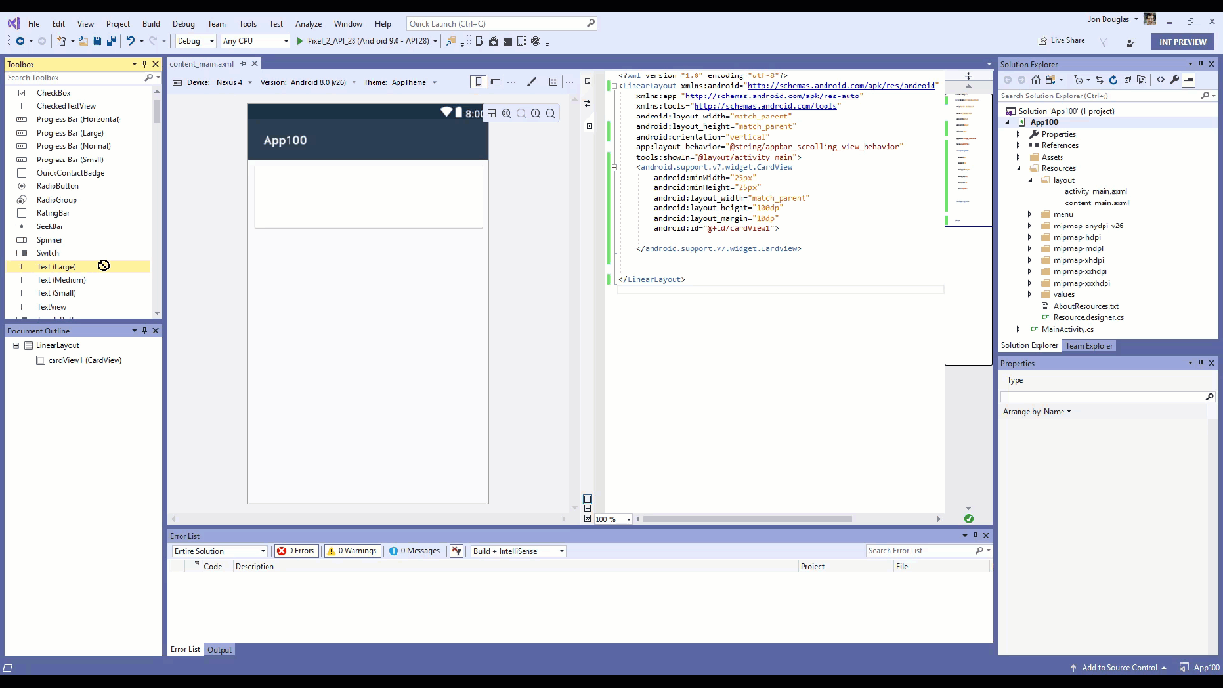
Xamarin Android Designer

Slide 31
What’s next for .NET – Mobile edition

Slide 32
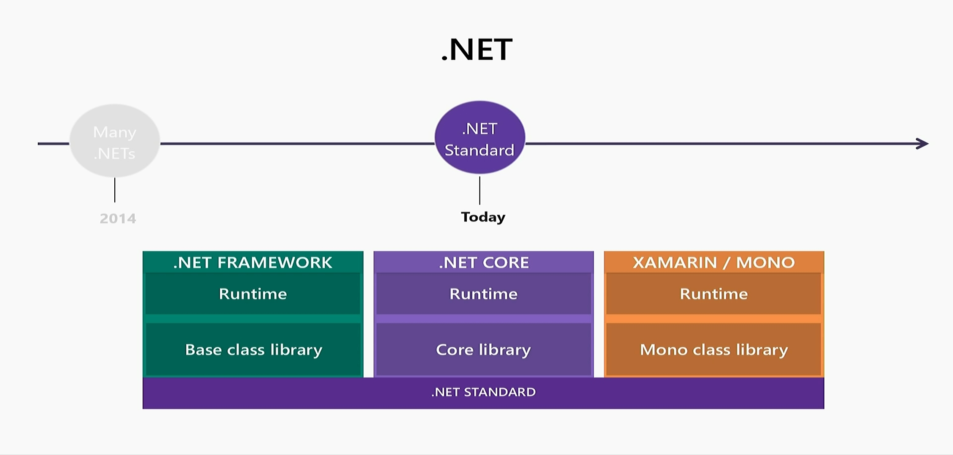
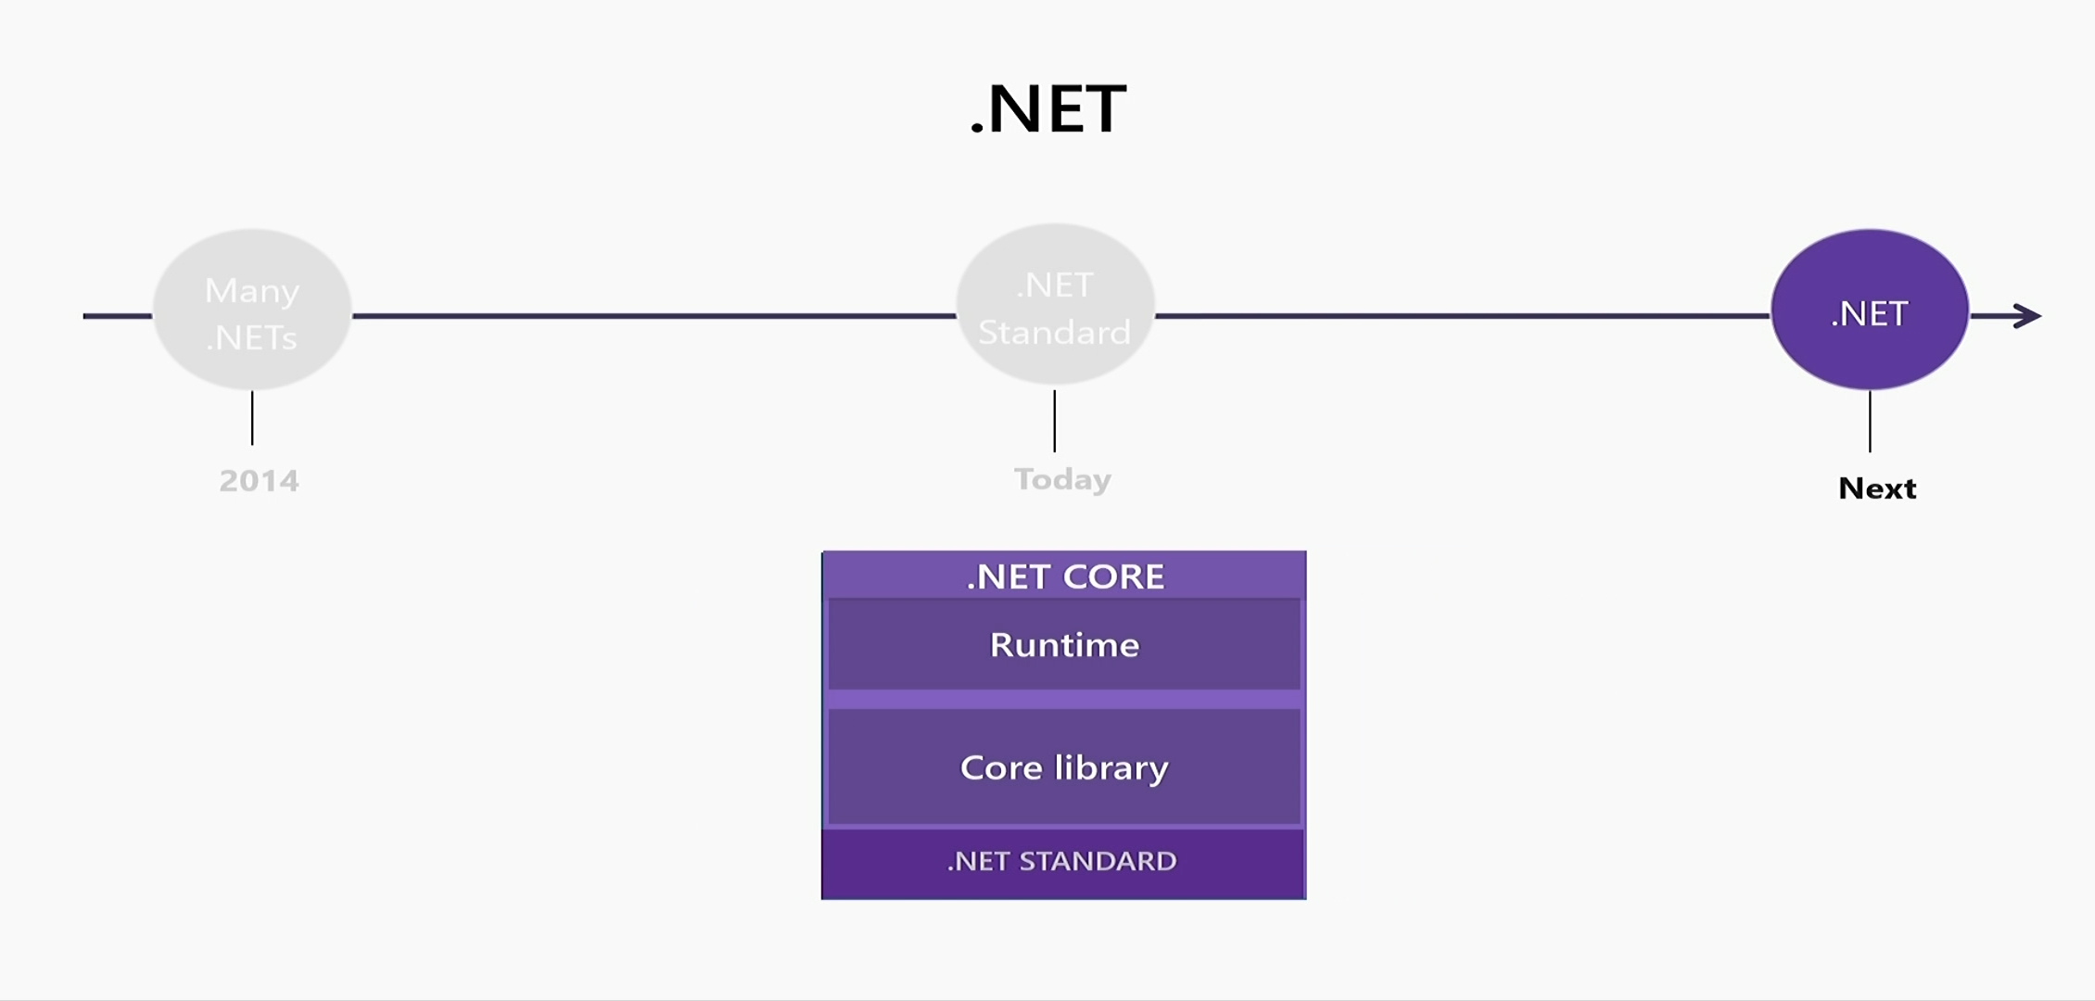
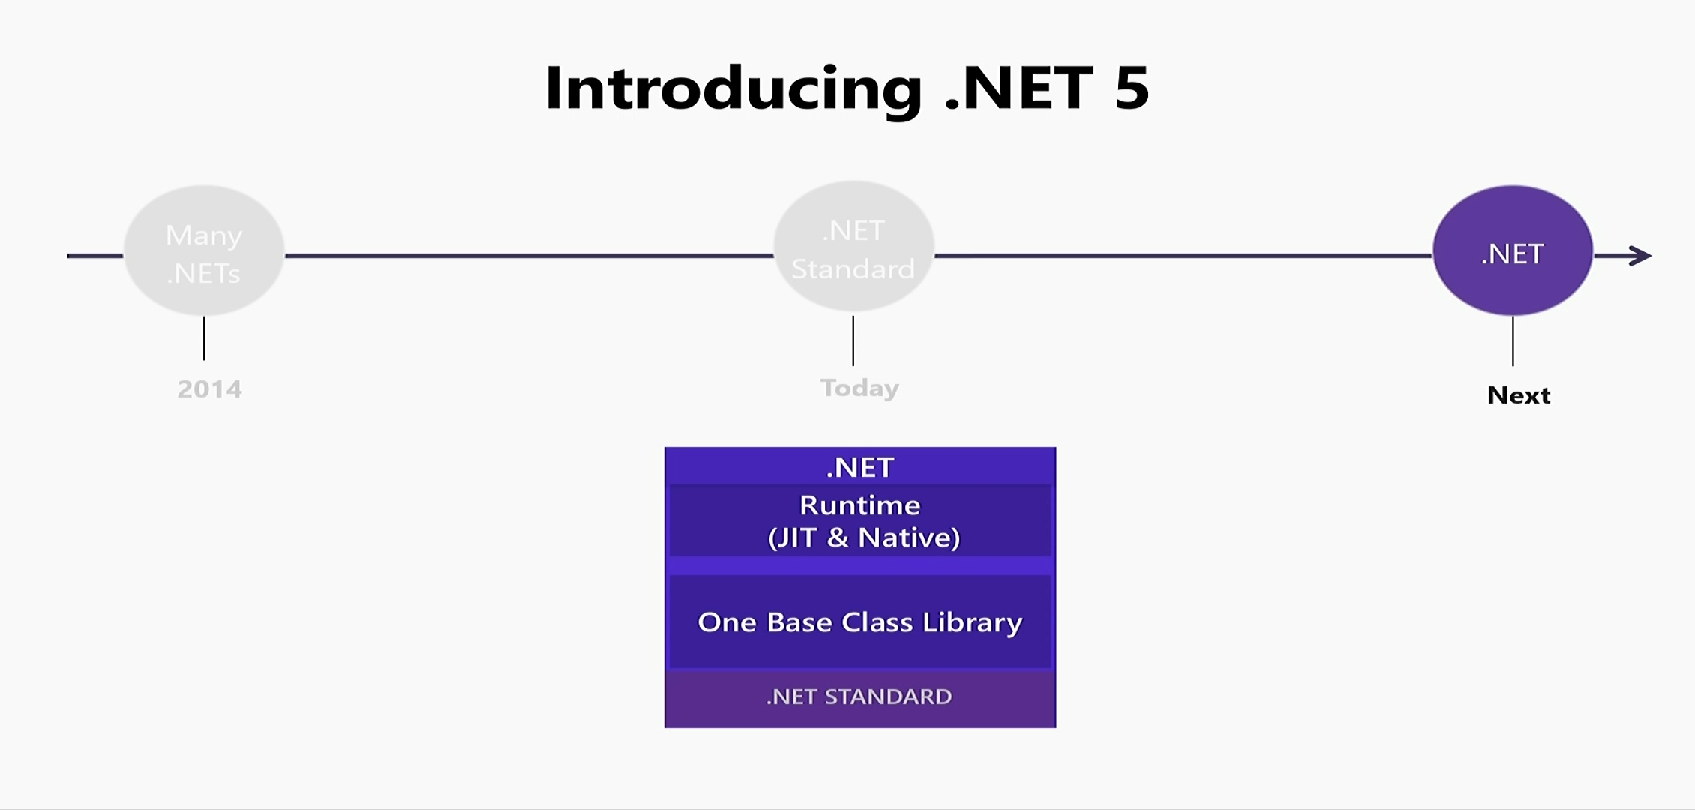

Slide 33
.NET 5
Supports all .NET application types
Once BCL implementation, still adheres to .NET Standard
One toolchain (SDK style projects)
Just-in-time (JIT), Static Compilation (Native/AOT), Interpreter
Interop with Java, Objective-C and Swift

Slide 34
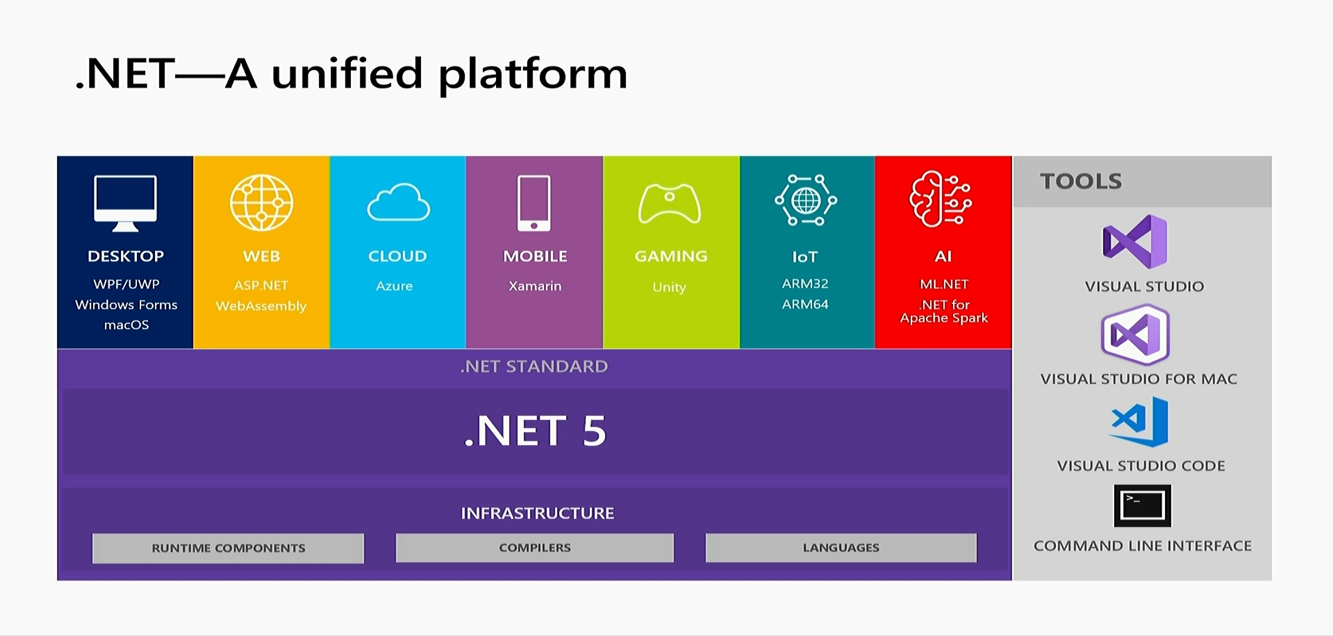

Slide 35
Any Queries?
☺
Harikrishnan
@cn_harikrishnan (https://twitter.com/cn_harikrishnan?s=08)
https://www.linkedin.com/in/hari-krishnan-304a0272
cnharishkrish@gmail.com

